Slide 1




CASE STUDY: FILTRATION OF SCRUBBER DUST
www.filtaquipglobal.com info@filtaquip.com
Notes:
https://youtu.be/axf21gGM5oY?si=F9zYa7E0KDpN17_C

Slide 2
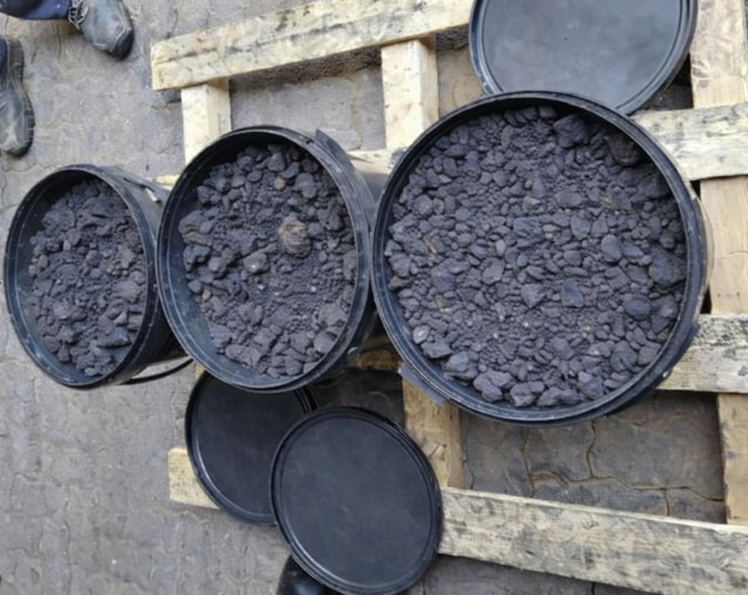
Background:
The Client’s Smelter consists of a Furnace that produces an off-gas which is very harmful to the environment, so a Scrubber is used to capture the dust, which forms a slurry, which is then pumped into a slurry Storage Facility. However, this handling method presents further environmental challenges. Filtaquip offered a solution to convert the Scrubber slurry into a dry filter cake, which is then recycled back into the Furnace, enabling the valuable metals to be recovered. As the solids have commercial value, the Client’s overall revenue was improved, whilst at the same time significantly reducing their Environmental impact.
Figure 1: Sample from Client

Slide 3
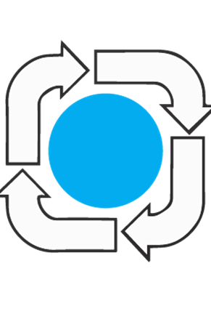
Objectives of Test work:
To assess:
filtration behaviour,
cake formation time, and
final moisture content
Assess optimal operating conditions:
Chamber depth
Membrane squeeze and Air-blow
It was essential to obtain a dry cake as possible, as it will be fed back to the Furnace!

Slide 4
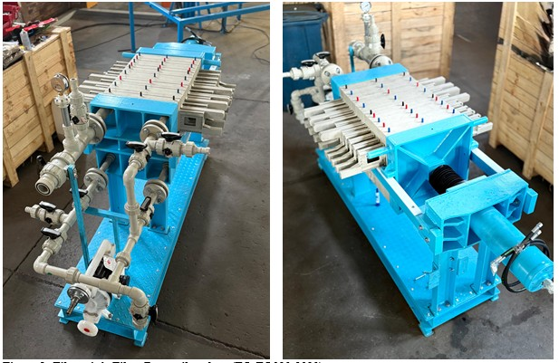
Why a Filter Press?
High capture efficiency of solid particles:
Particles are retained by a filter cloth, producing clear filtrate.
Low final cake moisture:
The use of membrane squeeze and air-blow reduces cake moisture significantly.
Water recovery and re-use:
Filtrate can be recycled back into the process, reducing overall water consumption.
Figure 2: FILTAQUIP Filter Press pilot plant

Slide 5
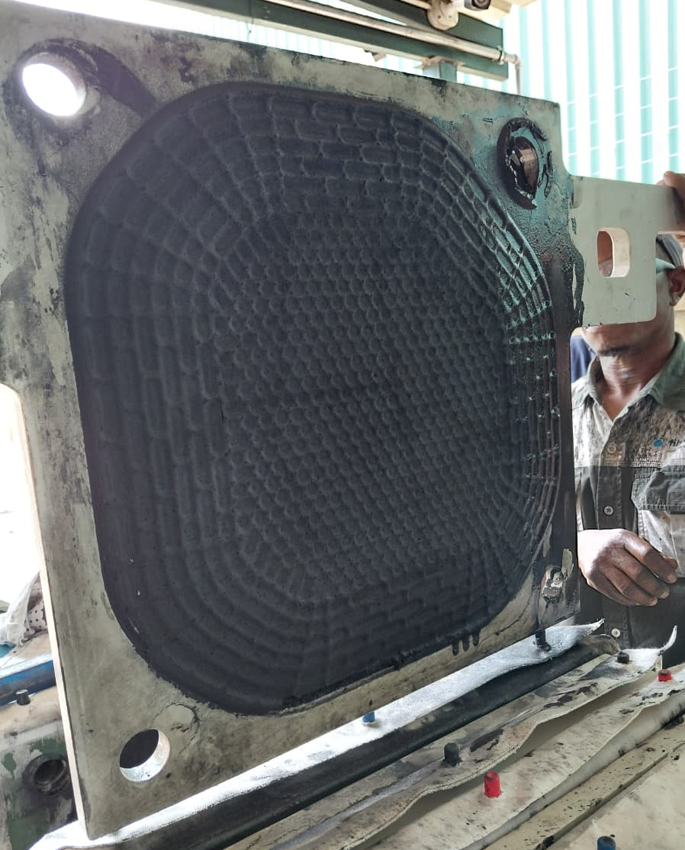
Filtration Test Results:
The Filter Press pilot plant test work assessed three different operating configurations by varying the pre-squeeze chamber depth and the dewatering sequence. In Test 1, a 30 mm chamber depth was used, followed by membrane squeezing and air-blowing, which produced a 19 mm thick, well-formed filter cake. Test 2 was carried out with an increased 40 mm chamber depth using the same squeeze-then-air-blow sequence, resulting in a thicker 30 mm filter cake. In Test 3, the chamber depth was again 30 mm, but the dewatering sequence was changed slightly, yielding a 23 mm thick filter cake. Across all tests, firm, dry-to-the-touch cakes were produced with consistently low final moisture contents with an average of 25% w/w, confirming effective dewatering under all tested conditions, which includes clear filtrate production.
Figure 3: Filter cake

Slide 6
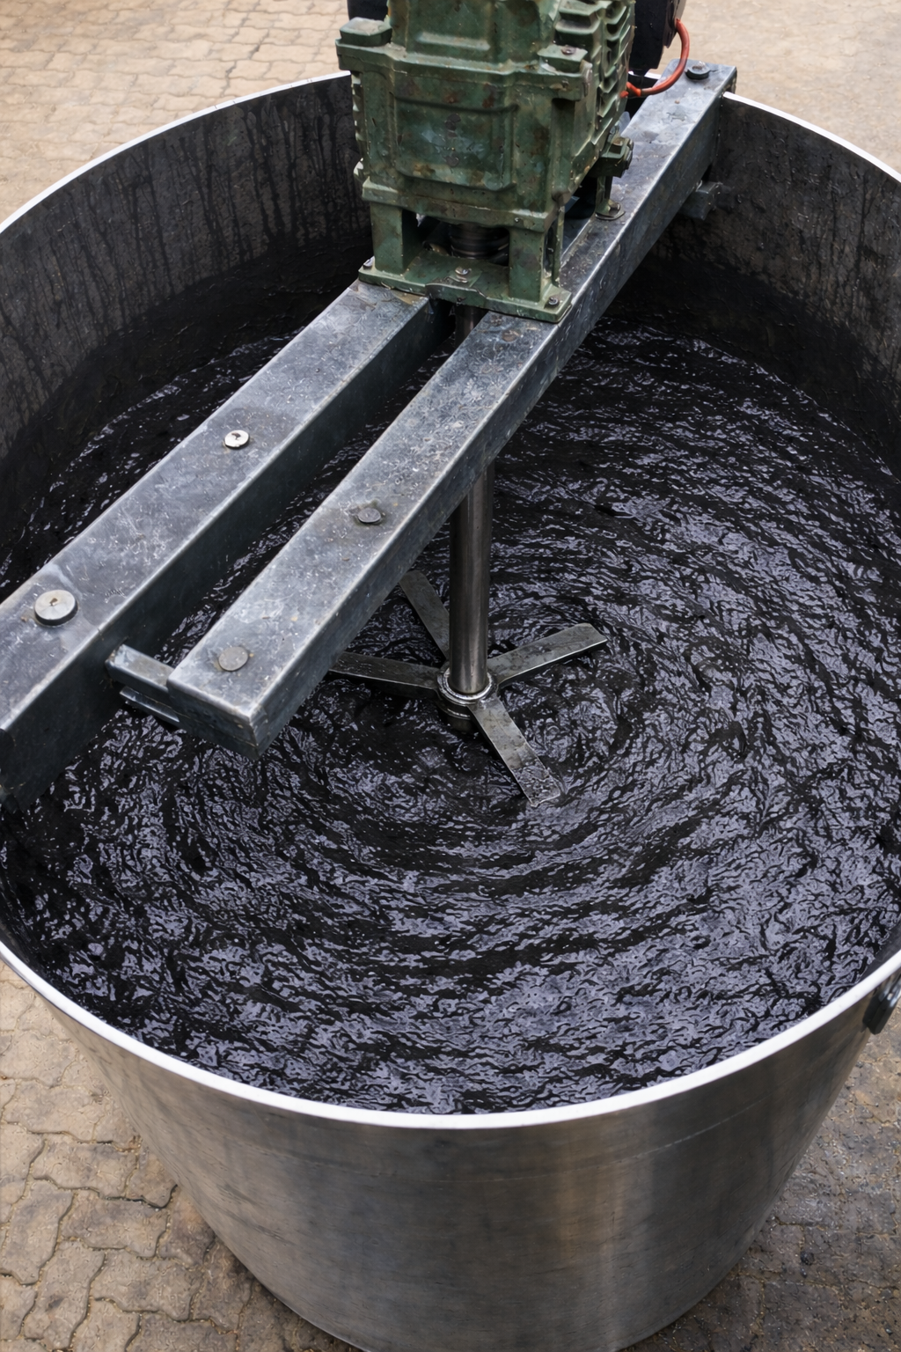
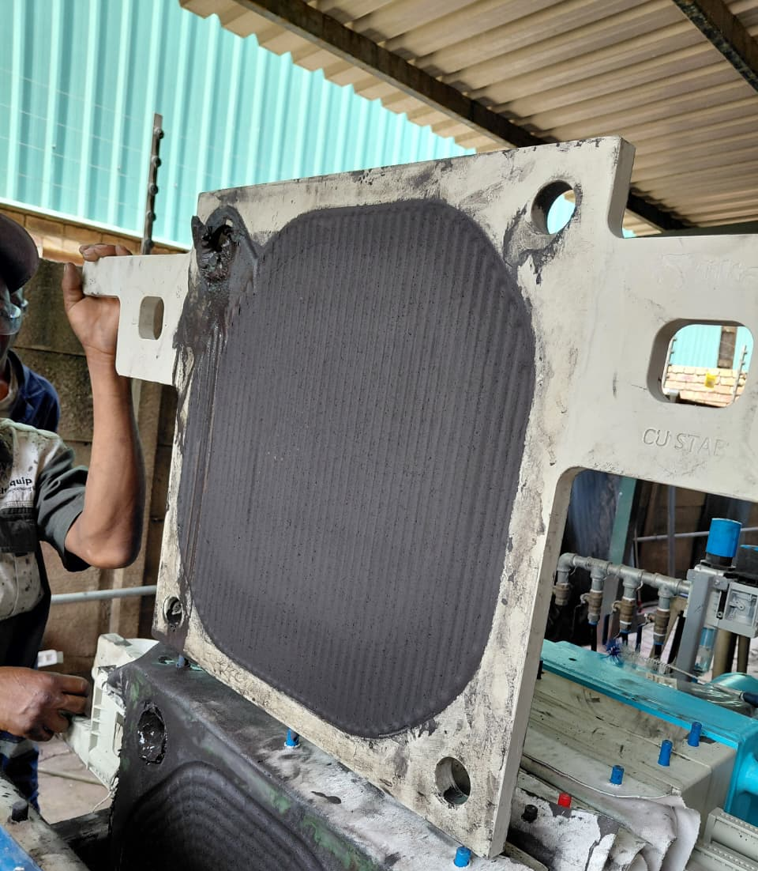
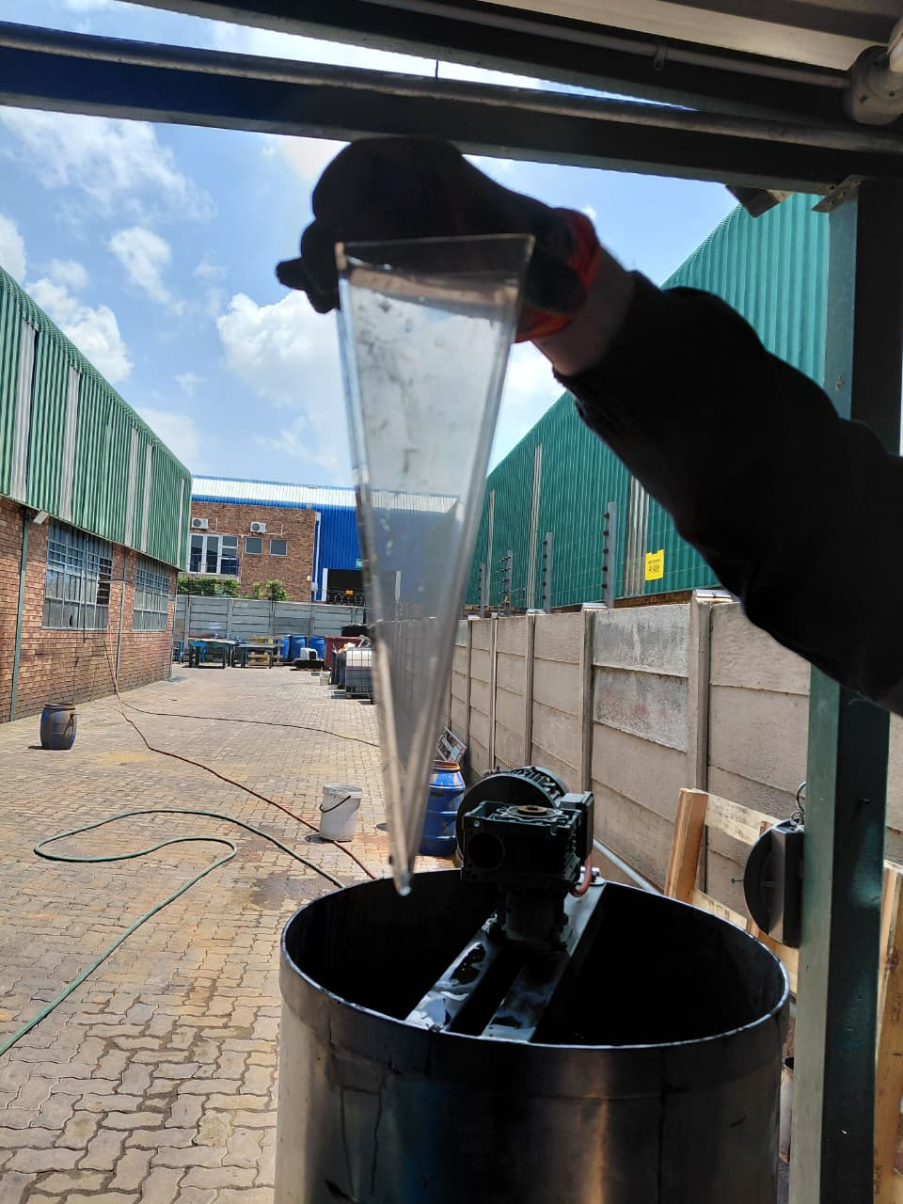
Before & After Filtration:
Figure 4: Feed Slurry
Figure 5: Filter cake
Figure 6: Clear Filtrate

Slide 7
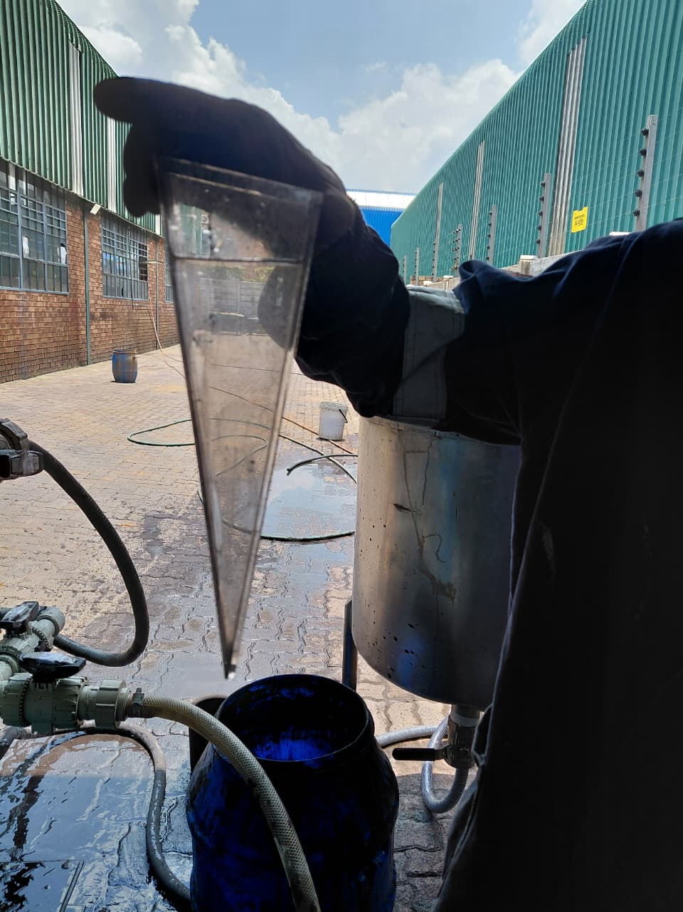
Conclusions:
Pilot test work confirmed that a Filter Press is effective for dewatering Scrubber Dust sludge, consistently producing firm, stable cakes with final moisture contents of ~25% w/w.
Membrane squeezing was the primary driver for moisture reduction, with air-blowing providing additional dewatering benefits.
Variations in chamber depth influenced final cake thickness, and total cycle times.
Initial filtrate quality was poor, however, this was easily addressed in the design of a full-scale Filter Press plant.
The results provide a reliable technical basis for the selection and sizing of a full-scale Filter Press plant, with membrane plates for clarifier sludge dewatering, as well as materials handling.

